Slide 1
Time-sensitive Personalized Query Auto-Completion
Date： 2015/01/29
Author： Fei Cai, Shangsong Liang, Maarten de Rijke
Source： CIKM’14
Advisor：Jia-ling Koh
Speaker：Sz-Han,Wang

Slide 2
Outline
Introduction
Method
Experiment
Conclusion

Slide 3
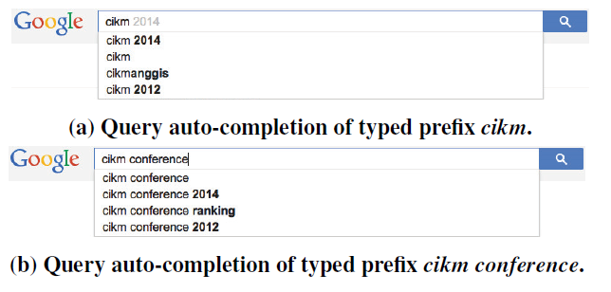
Introduction
Query auto-completion(QAC) is aimed at saving user’s time

Slide 4
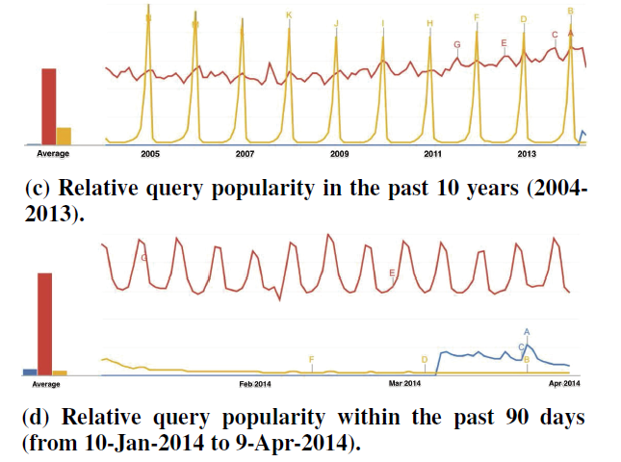
Introduction
A common approach:
  Extract past queries from query log, and rank them by their past popularity → performance on average but far from optimal
  Time and trend
MH370
movie
christmas

Slide 5
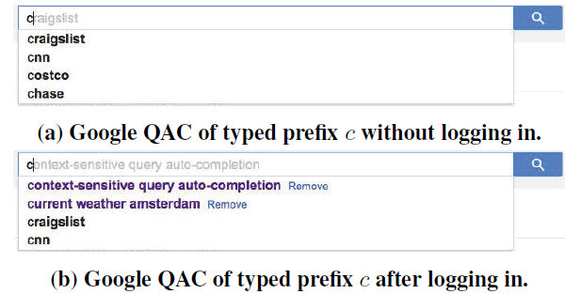
Introduction
  User-specific

Slide 6
Introduction
Goal:
  Propose a hybrid QAC model considers both of time-sensitivity and personalization to achieve optimal QAC effectiveness for a user.
  Time-sensitivity: predict query popularity based on periodicity of a query and its recent trend
  Personalization: exploit each user’s previous queries, both during the current session and from historical logs as user-specific

Slide 7
Flow Chart
Time-sensitive QAC
top N query completions
candidates
query
Rank QAC candidates by predicted query popularity
top N query completions
Personalized QAC
Hybrid QAC
Score user-specific query similarity
Rerank QAC candidates by combined time-sensitive QAC with personalized QAC

Slide 8
Outline
Introduction
Method
Experiment
Conclusion

Slide 9

Time-sensitive QAC
Rank QAC candidates by predicted query popularity
  Predict query popularity based on its recent trend and periodicity
  Time-sensitive score ${=\tilde{y}}_{t0+1}\left(q,λ\right)$
  $=λ×{\hat{y}}_{t0+1}{\left(q\right)}_{trend}+\left(1−λ\right)×{\overline{y}}_{t0+1}{\left(q\right)}_{peri}$

Slide 10




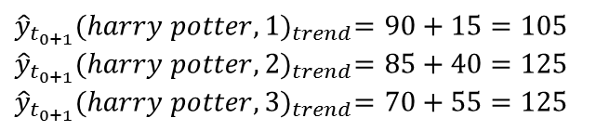

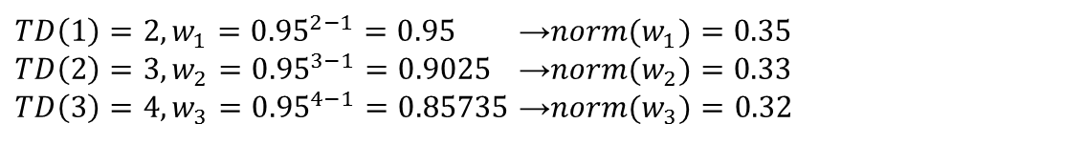



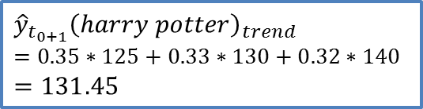

Time-sensitive QAC
    Predict form recent trend (recent N days)
f: decay factor, TD(i): the interval from day i to future day t0+1
harry
harry potter
harry winston
harry style
N days = 3, f=0.95
$${\hat{y}}_{t_{0+1}}{\left(harry potter\right)}_{trend}$$
$$=0.35∗125+0.33∗130+0.32∗140$$
$$=131.45$$
70
85
90
110
$${\hat{y}}_{t_{0+1}}{\left(harry potter\right)}_{trend}$$
$$t_{0−4}$$
$$t_{0−3}$$
$$t_{0−2}$$
$$t_{0−1}$$
$$t_{0}$$
$$t_{0+1}$$
${TD\left(1\right)=2,w}_{1}={0.95}^{2−1}=0.95$→${norm(w}_{1})=0.35$
${TD\left(2\right)=3,w}_{2}={0.95}^{3−1}=0.9025$ →${norm(w}_{2})=0.33$
${TD\left(3\right)=4,w}_{3}={0.95}^{4−1}=0.85735$ →${norm(w}_{3})=0.32$
$${\hat{y}}_{t_{0+1}}{(harry potter,1)}_{trend}=90+15=105$$
$${\hat{y}}_{t_{0+1}}{(harry potter,2)}_{trend}=85+40=125$$
$${\hat{y}}_{t_{0+1}}{(harry potter,3)}_{trend}=70+55=125$$

Slide 11






Time-sensitive QAC
    Predict form periodicity
      Use autocorrelation coefficient to detect q’s periodicity
, $T_{q}$ denotes q’s periodicity
$$T_{q}=1 year, M=3$$
harry
harry potter
harry winston
harry style
$${\hat{y}}_{t_{0+1}}{\left(harry potter\right)}_{peri}$$
100
95
120
$${\hat{y}}_{t_{0+1}}{\left(harry potter\right)}_{peri}$$
$$=\frac{1}{3}\left(100+95+120\right)$$
$$=105$$
2002/07/17
2003/07/17
2004/07/17
2005/07/16
2005/07/17
1
2
3
1
2
3
$$r_{1}=\frac{\left(1−2\right)∗\left(2−2\right)+\left(2−2\right)∗\left(3−2\right)+…+\left(2−2\right)∗(3−2)}{{(1−2)}^{2}+{(2−2)}^{2}+{…+(2−2)}^{2}}=−0.33$$
$$r_{2}=\frac{\left(1−2\right)∗\left(3−2\right)+\left(2−2\right)∗\left(1−2\right)+…+\left(1−2\right)∗(3−2)}{{(1−2)}^{2}+{(2−2)}^{2}+{…+(1−2)}^{2}}=−0.67$$
$$r_{3}=\frac{\left(1−2\right)∗\left(1−2\right)+\left(2−2\right)∗\left(2−2\right)+\left(3−2\right)∗(3−2)}{{(1−2)}^{2}+{(2−2)}^{2}+{(3−2)}^{2}}=1$$

Slide 12

Personalized QAC
Score user-specific query similarity
  Using a combination of similarity scores $Score(Q_{s}{,q}_{c})$ and $Score(Q_{u}{,q}_{c})$
    $Q_{s}$: the recent queries in the current search, $Q_{u}$: the same user issued before
  Personalized score $=ω×Score(Q_{s}{,q}_{c})+\left(1−ω\right)×Score(Q_{u}{,q}_{c})$

Slide 13

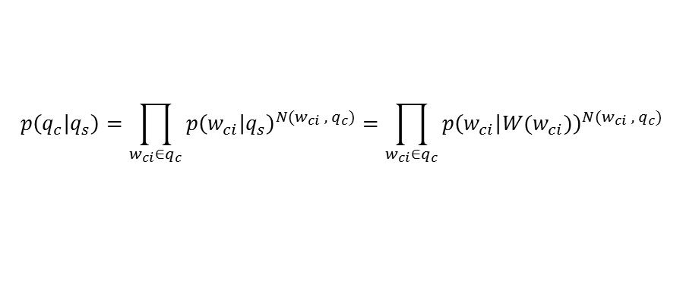
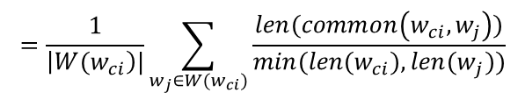
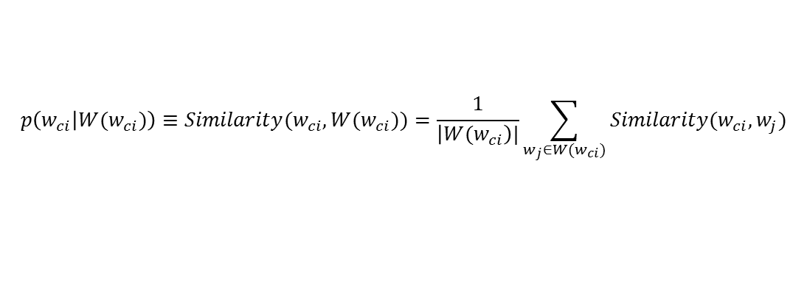
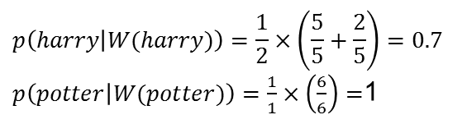
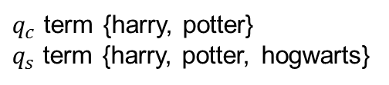


Personalized QAC
$$w_{s}=f^{TD\left(s\right)−1}$$
, f: decay factor, TD(s): the interval between $q_{c}$ and $q_{s}$
$$p\left(q_{c} | q_{s}\right)=\prod_{w_{ci}∈q_{c}}{{p\left(w_{ci} | q_{s}\right)}^{N(w_{ci} , q_{c})}}=\prod_{w_{ci}∈q_{c}}{{p\left(w_{ci} | {W(w}_{ci})\right)}^{N(w_{ci} , q_{c})}}$$
W($w_{ci}$)={$w:w∈q_{s}|w\left[0\right]=w_{ci}[0]$} ,N($w_{∗},q_{∗}$) denotes the frequency of term $w_{∗}$ appearing in $q_{∗}$
$$p\left(w_{ci} | {W(w}_{ci})\right)≡Similarity(w_{ci},W(w_{ci}))=\frac{1}{\left|{W(w}_{ci}\right)|}\sum_{w_{j}∈{W(w}_{ci})}{Similarity(w_{ci},w_{j})}$$
$$=\frac{1}{\left|{W(w}_{ci}\right)|}\sum_{w_{j}∈{W(w}_{ci})}{\frac{len(common\left(w_{ci},w_{j}\right))}{min({len(w}_{ci}),{len(w}_{j}))}}$$
harry potter
harry
harry potter hogwarts
$$p\left(harry potter | harry potter hogwarts\right)={0.7}^{\frac{1}{2}}×1^{\frac{1}{2}}=0.84$$
$$p\left(harry potter | harry potter hogwarts\right)$$
$$p\left(harry | W(harry)\right)=\frac{1}{2}×\left(\frac{5}{5}+\frac{2}{5}\right)=0.7$$
$p\left(potter | W(potter)\right)=\frac{1}{1}×\left(\frac{6}{6}\right)=$1
$q_{c}$ term {harry, potter}
$q_{s}$ term {harry, potter, hogwarts}
W(harry)= {harry, hogwarts}
W(potter)= {potter}
, $w_{u}$ depend on the query count

Slide 14
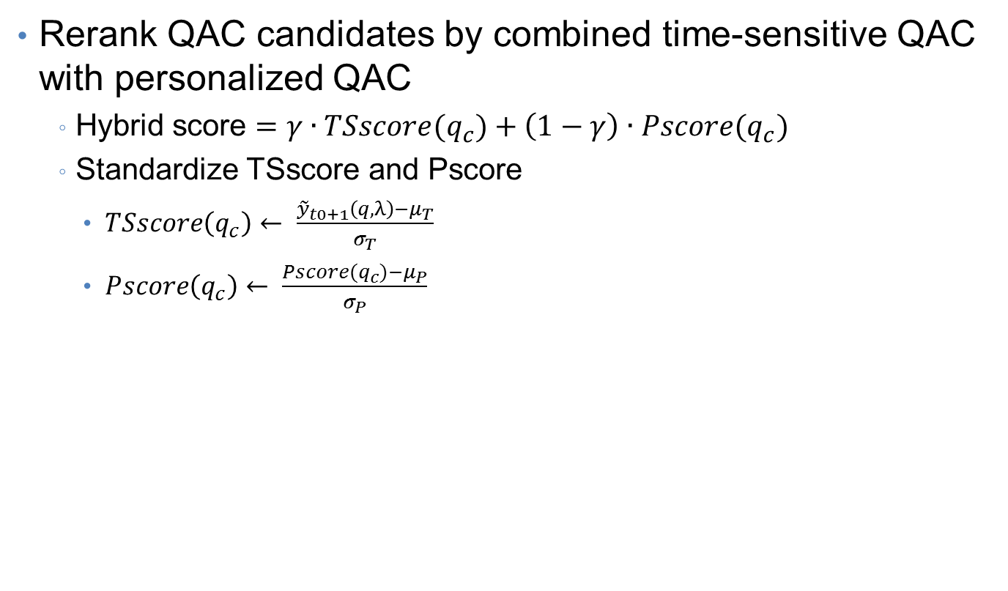
Hybrid QAC
Rerank QAC candidates by combined time-sensitive QAC with personalized QAC
  Hybrid score $=γ∙TSscore(q_{c})+\left(1−γ\right)∙Pscore(q_{c})$
  Standardize TSscore and Pscore
    $TSscore\left(q_{c}\right)← \frac{{\tilde{y}}_{t0+1}\left(q,λ\right)−μ_{T}}{σ_{T}}$
    $Pscore\left(q_{c}\right)← \frac{Pscore(q_{c})−μ_{P}}{σ_{P}}$

Slide 15
Outline
Introduction
Method
Experiment
Conclusion

Slide 16
Experiment
Dataset
  AOL sampled between 2006/03/01 and 2006/05/31
  Sound and Vision sampled between 2013/01/01 and 2013/12/31

Slide 17
Experiment
Evaluation metrics
  Measure forecast accuracy
    Mean Absolute Error (MAE)
    Symmetric Mean Absolute Error
  Evaluate the effectiveness of QAC rankings
    Mean Reciprocal Rank (MRR)
$$y_{i}:the true value, {\hat{y}}_{i}:the prediction value$$

Slide 18
Experiment
Query popularity prediction evaluation

Slide 19
Experiment
Impact of trade-off parameter
0.62
0.83

Slide 20
Experiment
Performance of TS-QAC rankings
Performance of Hybrid QAC rankings

Slide 21
Outline
Introduction
Method
Experiment
Conclusion

Slide 22
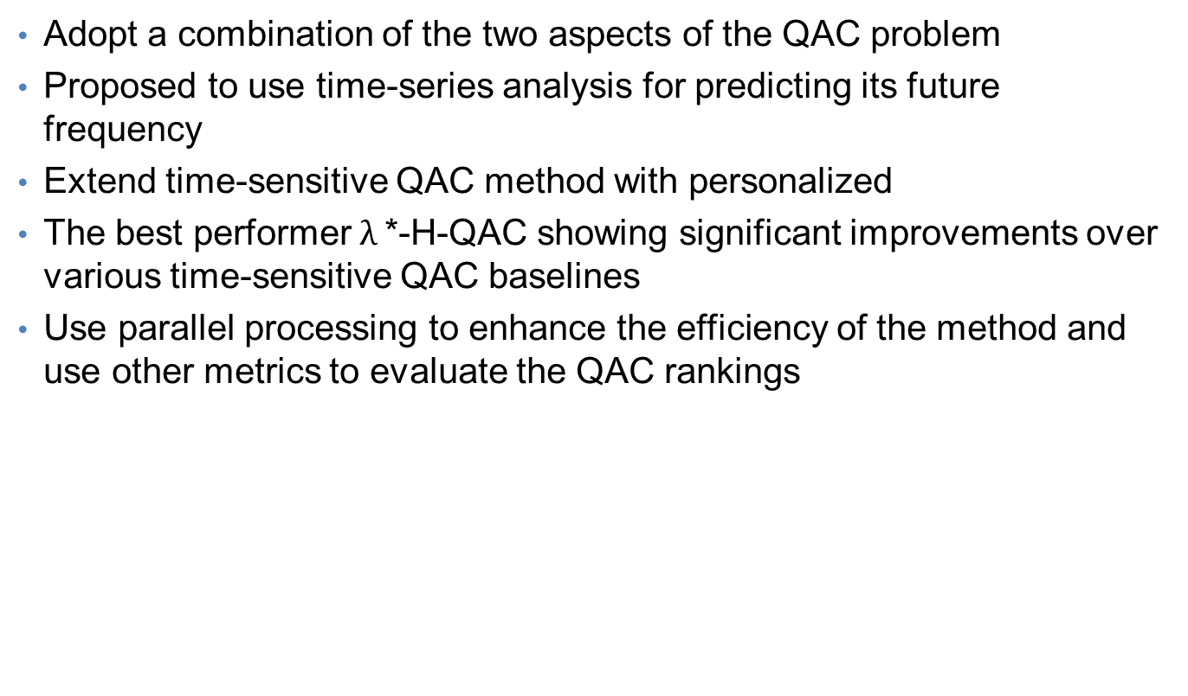
Conclusion
Adopt a combination of the two aspects of the QAC problem
Proposed to use time-series analysis for predicting its future frequency
Extend time-sensitive QAC method with personalized
The best performer $λ$*-H-QAC showing significant improvements over various time-sensitive QAC baselines
Use parallel processing to enhance the efficiency of the method and use other metrics to evaluate the QAC rankings

